Slide 1

REQUIREMENT ANALYSIS
Crowdsensed DriveTest Mobile Application
Group 6 | Task 3 Presentation

Slide 2
01. Review of Gathered Requirements
Analyzing technical and operational data from the user survey and research phase.

Slide 3

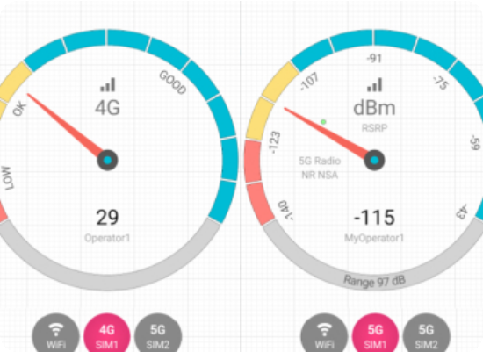
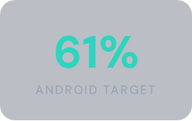
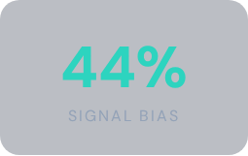
User Survey & Data Analysis
Survey Sample: 75 Participants
Platform Dominance: 61.3% users on Android (v14), prioritizing Android Telephony Manager API.
The "Ghost Signal" Issue: 44% report high bars but no data; highlighting need for RSRQ/SINR metrics.
User Technical Literacy: 34% unaware of specs, requiring a fully automated sensing approach.

Slide 4






Technical Feasibility Analysis
Power Efficiency
Offline Durability
48% of users demand battery drain <5%. We must utilize Passive Sensing and adaptive polling to maintain project feasibility.
85% report network instability. SQLite local storage is a technical necessity for the Store-and-Forward logic.
Geotagging Logic
Privacy vs Mapping
49% of users disable GPS. Application must implement efficient Location Permission Modules to ensure data spatial accuracy.
77% are excited for Live Maps. We must finalize Device ID hashing (HMAC-SHA256) to anonymize user data.

Slide 5




Inconsistencies & Ambiguities
Vague Definitions
Missing Information
Terms like "Fast" and "Secure" lacked measurable criteria. Action: Defined performance benchmarks and HTTPS/TLS 1.2+ protocols.
No initial definition of User Roles (Admin, Tester, Analyst) or Error Handling processes was found in early drafts.
Technical Gaps
User-Related Gaps
Technology stack and API integration requirements were not specified. Resolution: Selected Kotlin/Jetpack and Retrofit stack.
Missing Target Audience description and Journey Mapping. Application now targets Buea University community specifically.

Slide 6
02. Requirement Prioritization
Balancing importance and feasibility to build a Minimum Viable Product (MVP).

Slide 7
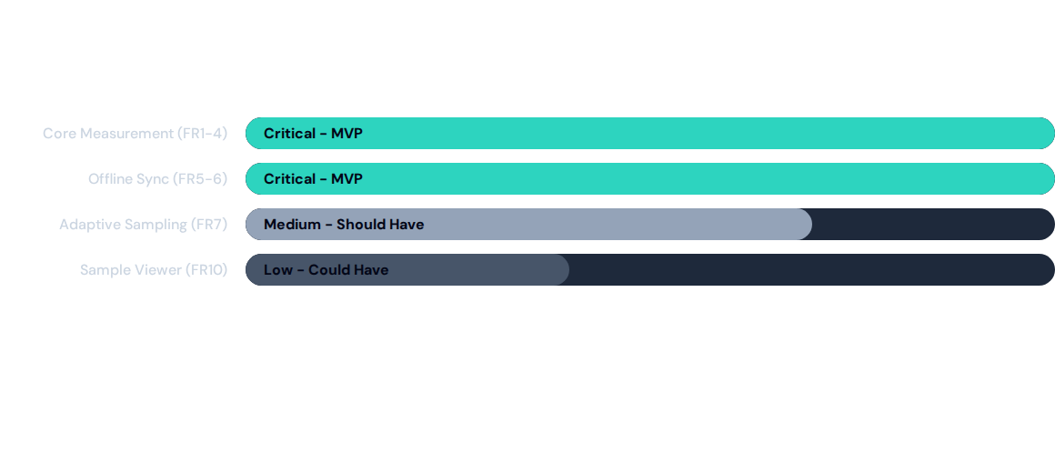
Requirement Priority Matrix
High Importance + High Feasibility features are prioritized for the initial development sprint.

Slide 8
Functional Requirements (FR)
RF Metric Acquisition: System must extract RSRP, RSRQ, SINR, and RSSI programmatically.
Secure Sync: Automatic HTTPS/TLS transmission of batches when a stable connection is detected.
Geospatial Tagging: Append GPS (lat, lon) and altitude to every measurement packet.
Hole Analysis: Backend processing to identify signal strength below the -110 dB threshold.
Offline Persistence: Local storage (Room/SQLite) to cache data during network blackouts.
Network Identity: Mapping Cell ID and LAC to associate data with base stations.

Slide 9

Non-Functional Specs
Operating Standards
Power: Sensing must not exceed 8% battery consumption per 24-hour cycle to avoid user uninstalls.
Reliability: Utilizes Android Foreground Services to prevent OS kernel termination during background idle states.
Accuracy: GPS coordinates must be captured within 10m precision for valid coverage heatmap generation.
Scalability: Backend must support 10,000+ concurrent data streams via Kafka/SQS buffering.

Slide 10
03. Software Requirements Specification
Final system architecture, data models, and stakeholder validation strategies.

Slide 11
SRS System Overview
User Class | Core Functionality | Data Interaction
Field Tester | Data Collection Sessions | Collects RSRP, GPS, Throughput
Operator Analyst | Analytics & Reporting | Views Heatmaps and Hole Reports
Privacy Officer | Data Compliance | Reviews Consent & Deletion Requests
Developer/QA | System Maintenance | API Integration & Performance Tests

